Slide 1
INTRODUCTION TO MACHINE LEARNING
- Prajin khadka
Twitter : @prajin11592704
Github : @prajinkhadka

Slide 2
Contents :
1. Introduction to Artificial Intelligence
2. AI vs ML vs DL
3. Introduction to Machine Learning
4. Applications
5. Types of Machine learning
6. Getting started

Slide 3
AI : Artificial Intelligence
How would you define intelligence ?

Slide 4
AI : Artificial Intelligence
How would you define intelligence ?
- You are intelligent because you have the capability to learn – and solve problems.

Slide 5
AI : Artificial Intelligence
How would you define intelligence ?
- You are intelligent because you have the capability to learn – and solve problems.
So,
INTELLIGENCE IS THE ABILITY TO LEARN AND SOLVE "NEW PROBLEMS"
AI – JUST A WAY TO GIVE MACHINES THE “INTELLIGENCE”

Slide 6
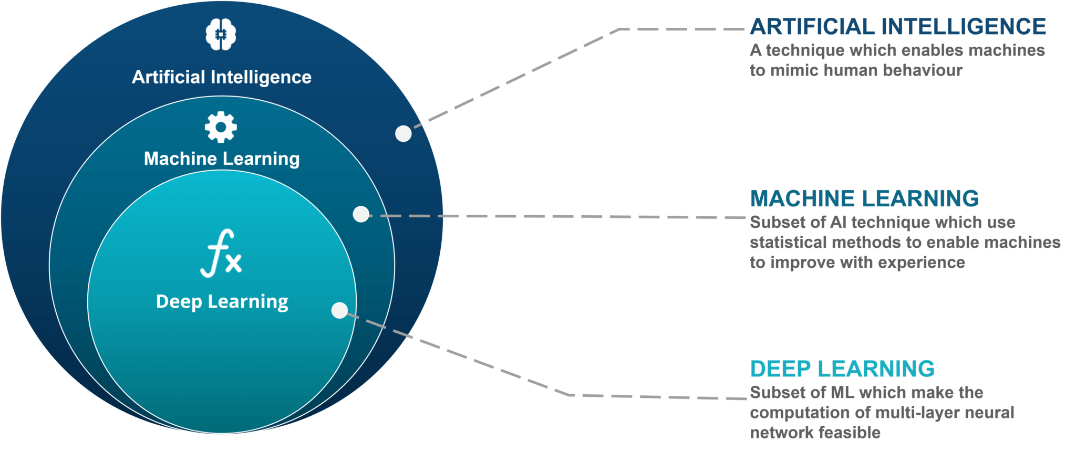

Slide 7
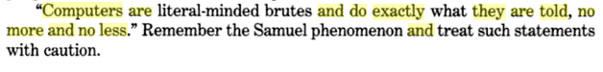
Machine Learning : Field of study that gives computers ability to learn without being explicitly programmed.
1992 :
ARTIFICIAL INTELLIGENCE AND BUSINESS MANAGEMENT (1992)
Derek Partridge
Now :
Computers can do whatever data they are given,YES WHATEVER

Slide 8
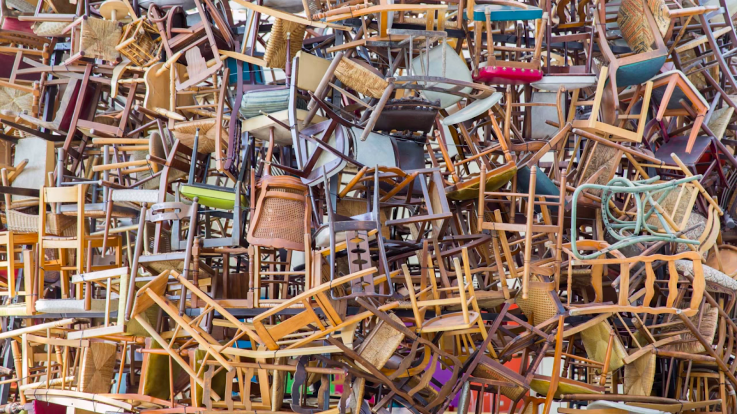

Slide 9

Pseudocode
If image has :
4 legs
Flat surface for sitting.
Backrest
It’s a chair

Slide 10

Pseudocode
If image has :
4 legs
Flat surface for sitting.
Backrest
NOW??

Slide 11
Smith | $2,600.45 | No
Potter | $2,294.58 | Yes
Peters | $1,003.30 | Yes
Adams | $8,488.32 | No

Slide 12
Smith | $2,600.45 | USA | USA | 22 | No
Potter | $2,294.58 | USA | RUS | 29 | Yes
Peters | $1,003.30 | USA | RUS | 25 | Yes
Adams | $8,488.32 | FRA | USA | 64 | No
Pali | $200.12 | AUS | JAP | 58 | No
Jones | $3,250.11 | USA | RUS | 43 | No
Hanford Marx Norse | $8,156.20 $7,475.11 | USA UK | RUS GER | 27 32 | Yes No
 | $540.00 | USA | RUS | 27 | No
Edson | $7,475.11 | USA | RUS | 20 | Yes

Slide 13
Best way to make Machines Intelligent is by learning from examples.
! SETTING THE FIXED RULES.

Slide 14
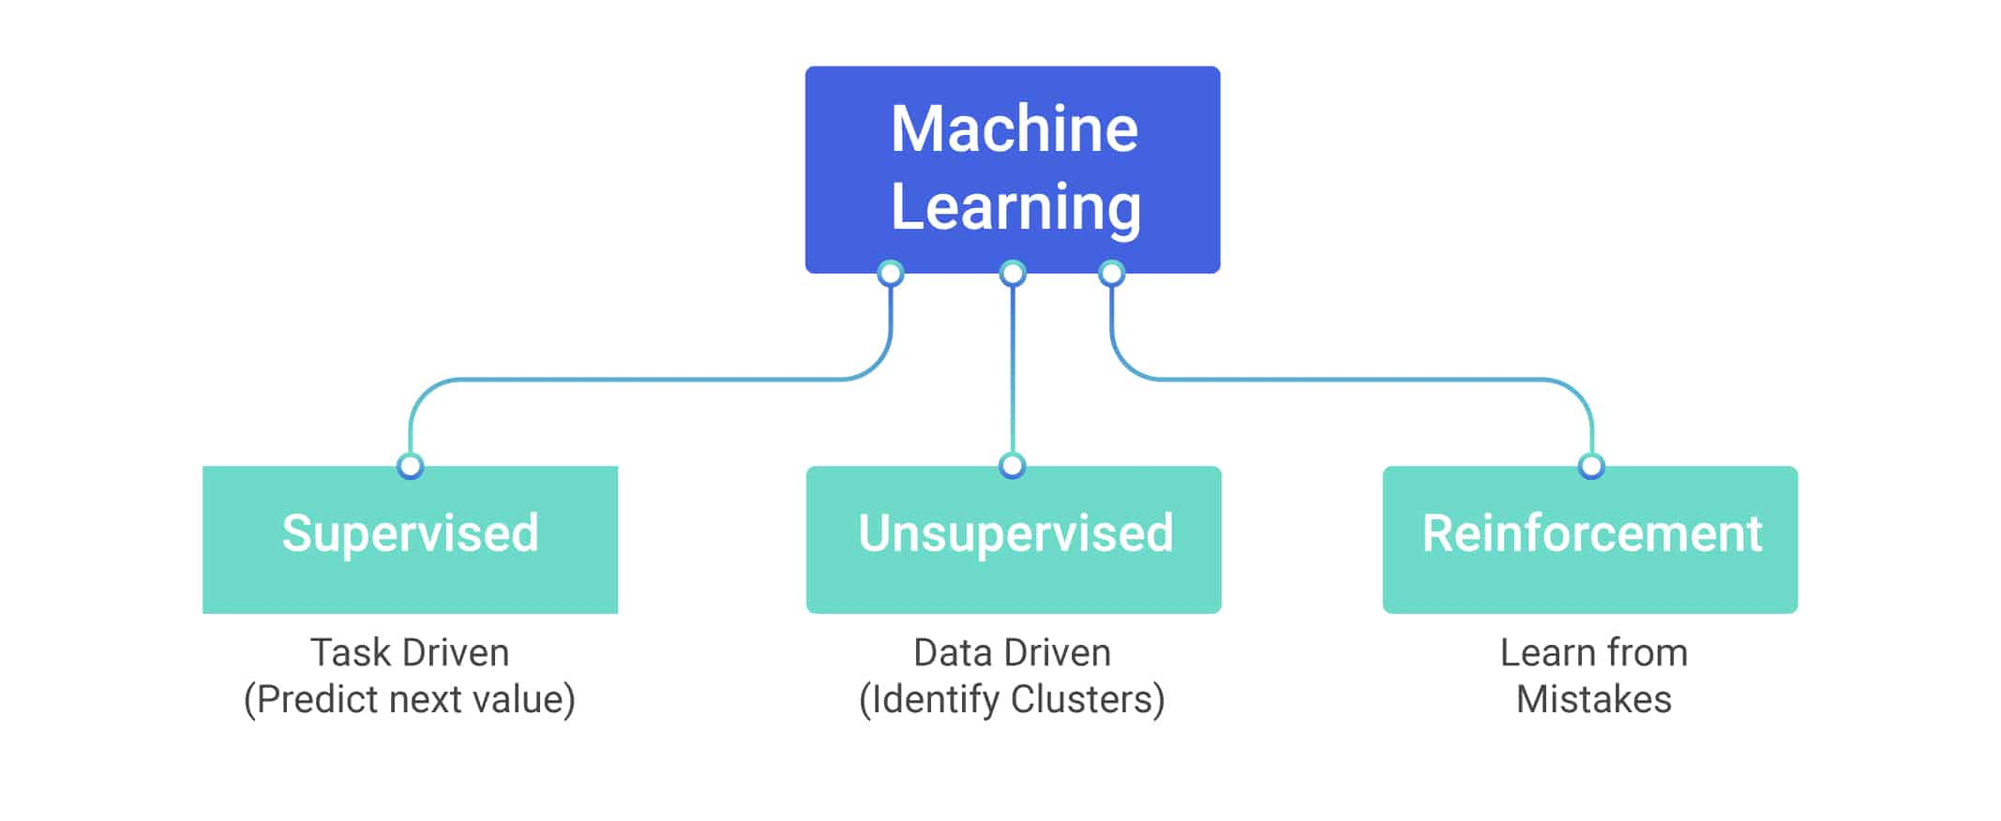

Slide 15
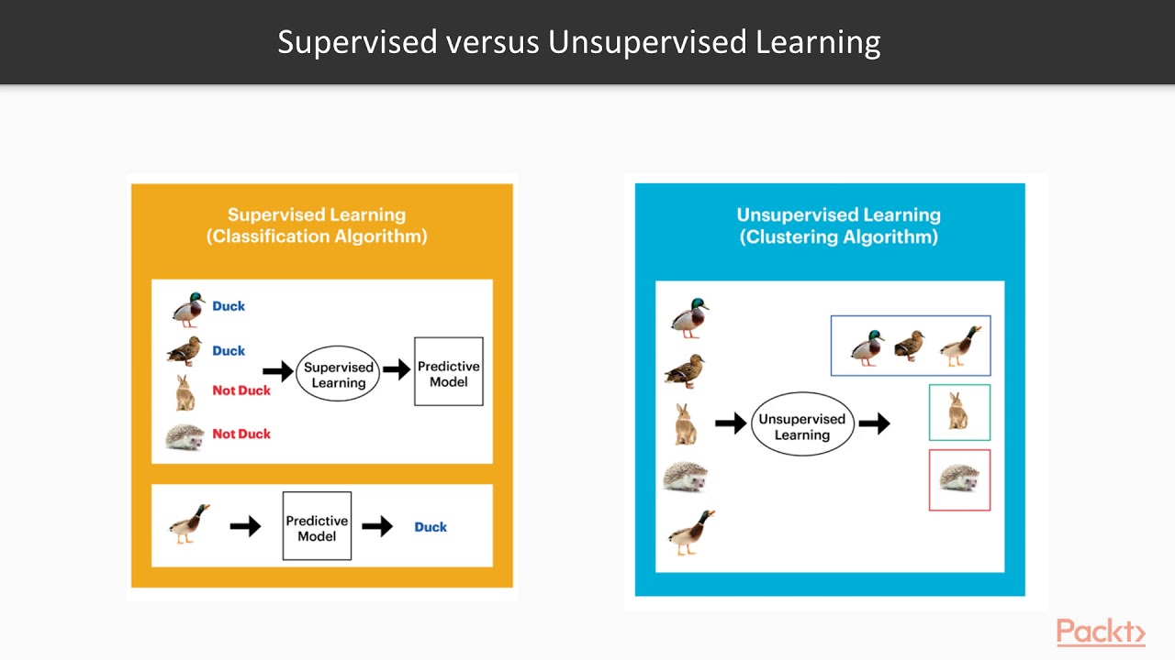

Slide 16
Paradigms of Supervised Learning
Regression – Output is Continuous real value.
Classification – Output is categorical value , yes or no , male or female etc

Slide 17
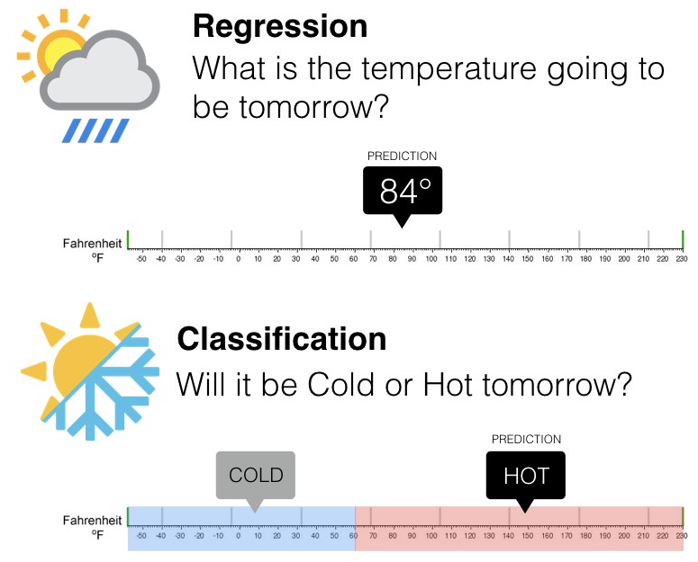

Slide 18
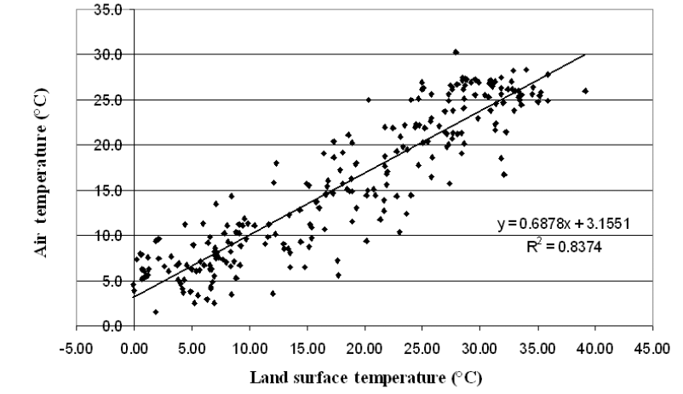

Slide 19
Applications of Supervised Learning
Spam Detection
Predicting Covid19 infection from X ray images.
Predicting if review is positive or not.
Prediction if a comment in Social media is hate speech or not.
Predicting tomorrows weather from the past data.
and much more..

Slide 20
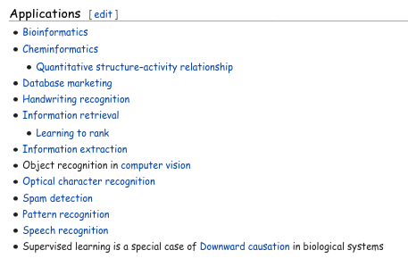
Applications of Supervised Learning

Slide 21
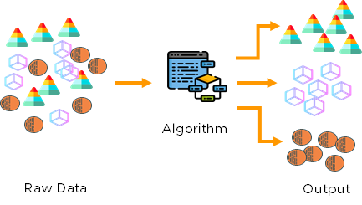
Unsupervised Learning : Clustering

Slide 22
Applications of Unsupervised Learning
Customer Segmentation
Image Segmentation
Grouping same genes.
Recommender Systems.
More on wikipedia

Slide 23
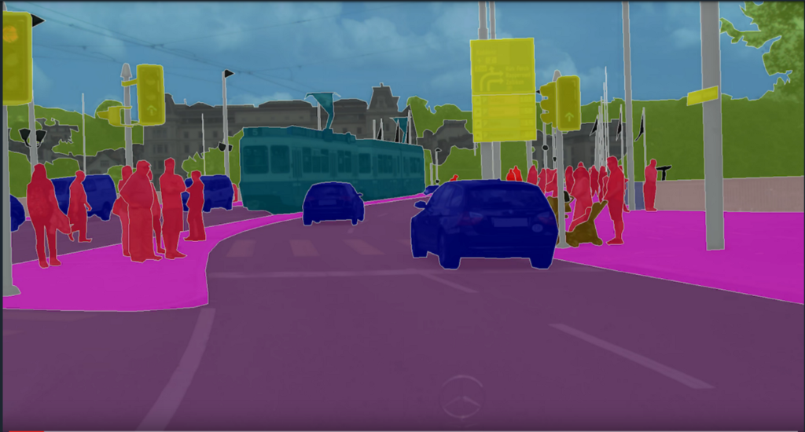

Slide 24
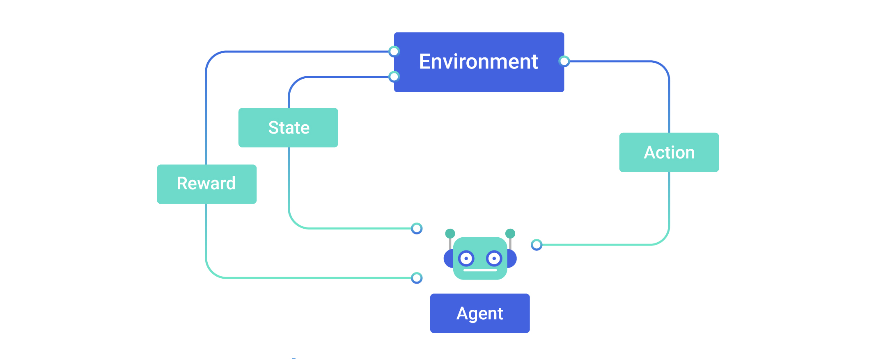
Reinforcement Learning

Slide 25
Applications of Reinforcement Learning
Self Driving Car ( Tesla )
Game Playing ( DeepMind )
https://www.alphagomovie.com
Robotics
Text Mining ( Salesforce )
Trade Execution ( JPMorgan )
Health Care ( Finding potential drugs for cure )

Slide 26
Getting Started
Knowledge on Python or R:
Python for Beginners( Microsoft Developer )
Andrew NG ( Machine Learning - Stanford )
Azure Machine Learning ( End to End )
a. https://azure.microsoft.com/en-us/services/machine-learning/
b. Azure ML Studio - https://studio.azureml.net/
Applied Machine Learning in Python ( Coursera )
More Resources :
Linear Algebra - 18.06 ( GIlbert Strang )
CS109 ( Stanford - shorturl.at/jnFGW ) Elements of Statistical Learning ( Book )
Machine Learning a Probabilistic approach ( Kevin Murphy )
pattern recognition and machine learning ( Christopher Bishop )

Slide 27
DISCUSSIONS
Thank you for Listening

